Slide 1

GPS Tracker

Slide 2

Group members
Vương Minh Phú 1551112
Lê Hoàng Giang 1551032

Slide 3

Applications

Slide 4

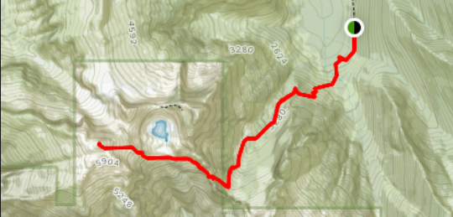
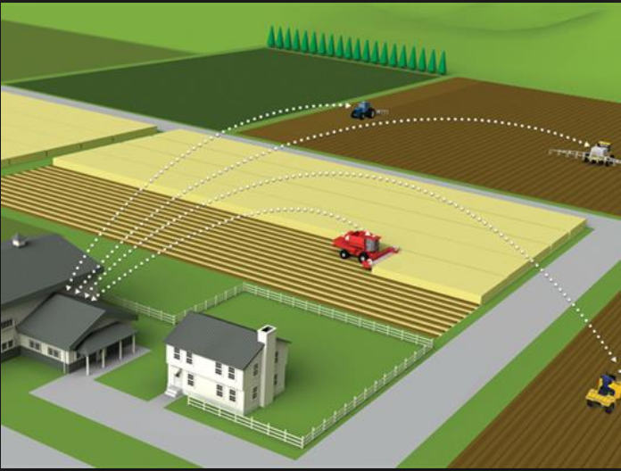
Tracker: climbing, backtracking
Security: find your phone
Farming

Slide 5
Solution

Slide 6
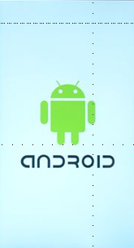

Build an Android app to take the location.
A Website to show results

Slide 7
APP ARCHITECTURE

Slide 8


BUILDING TOOLS

Slide 9
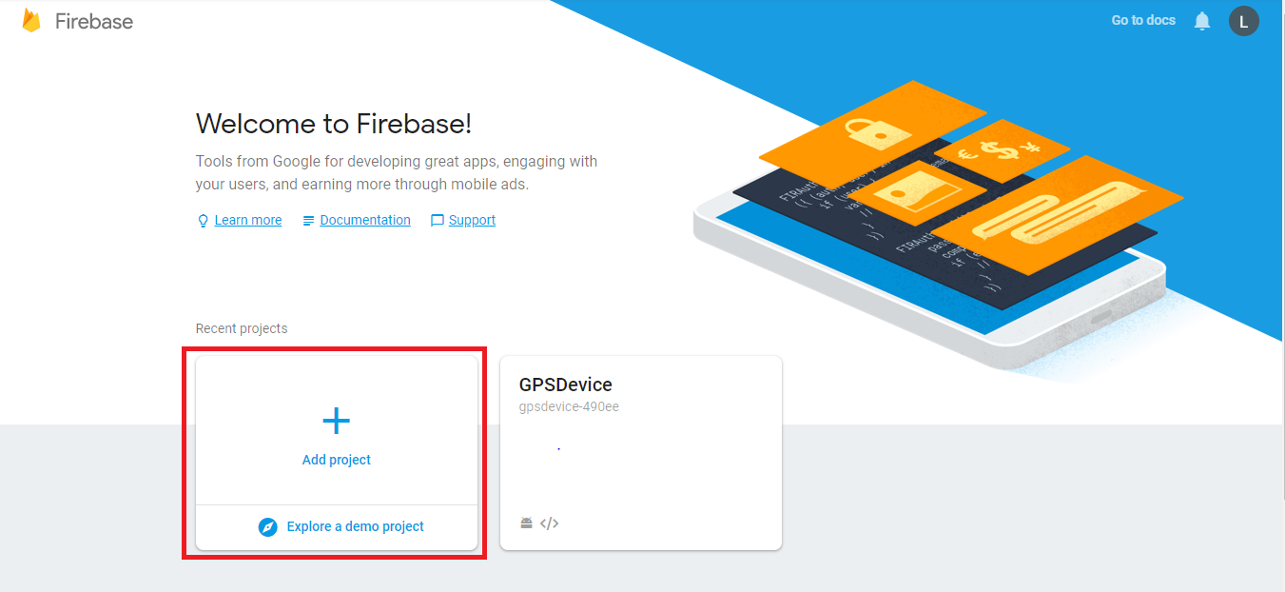
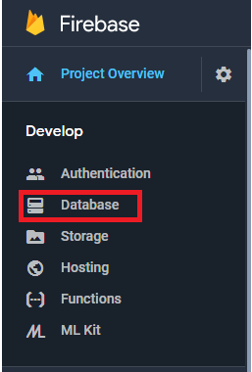
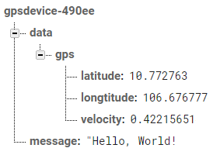
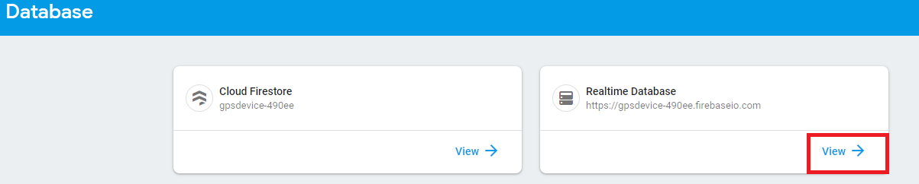
Firebase
second
second

Slide 10
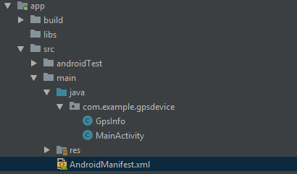


IN MANIFEST

Slide 11
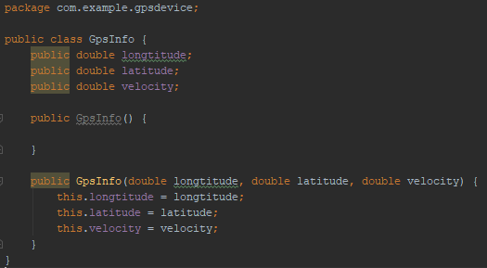
INITIAL JAVA FUNCTION

Slide 12
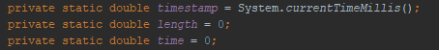
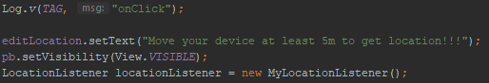

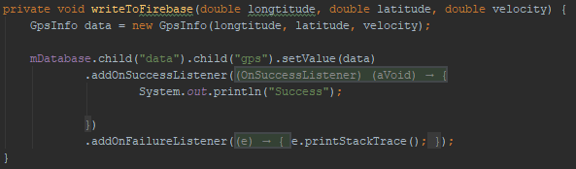
MAIN JAVA FUNCTION

Slide 13
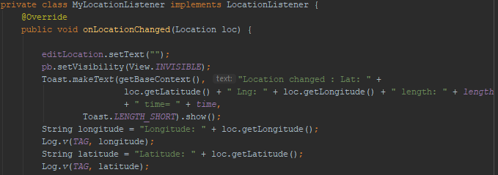
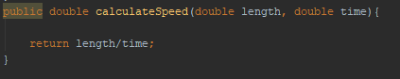
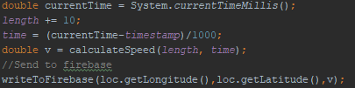
GET LOCATION

Slide 14

User Interface

Slide 15




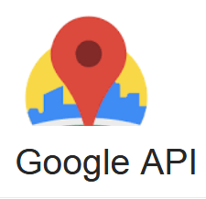

Web design
White
Gray
Black
Black
Black

Slide 16

Web design:
Positions
Path
Estimate velocity

Slide 17

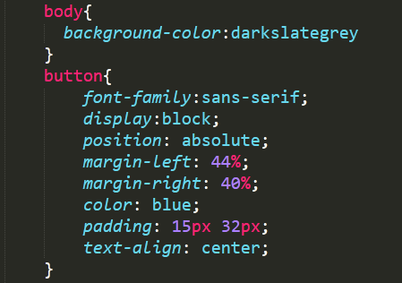
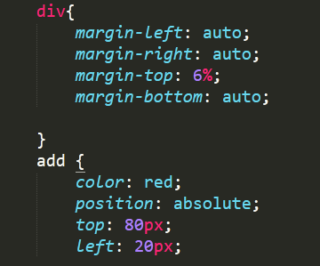
CSS

Slide 18

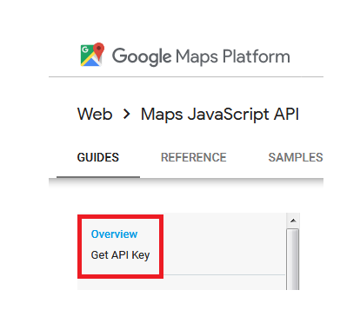
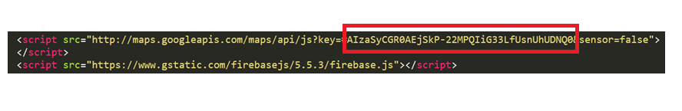
javascript
second

Slide 19
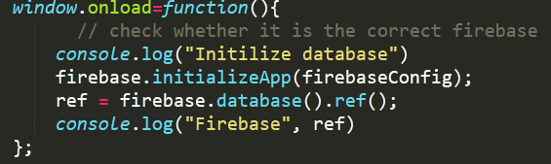
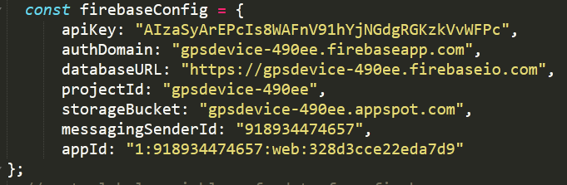
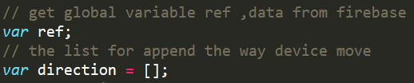

Slide 20
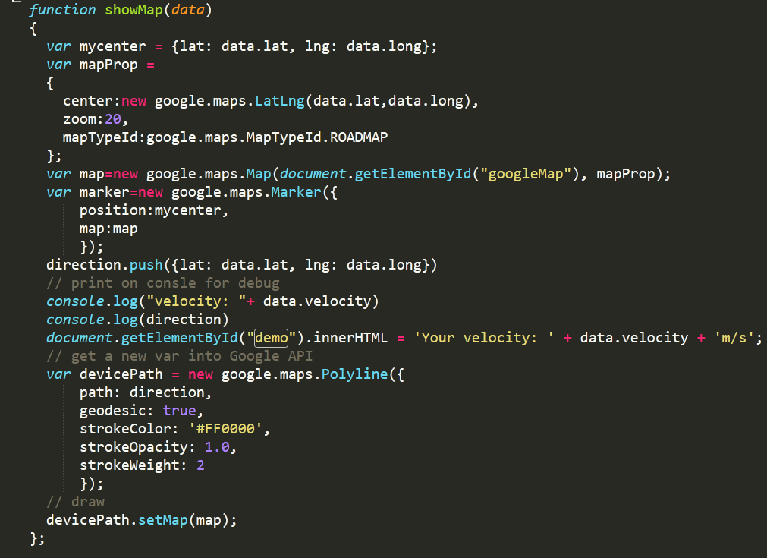
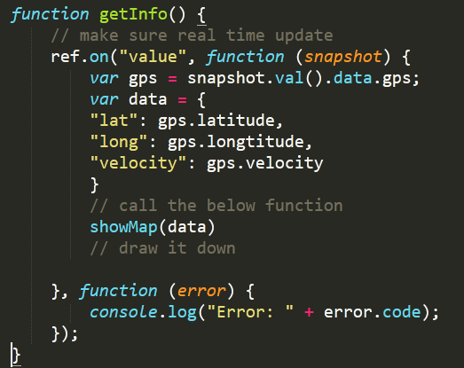

Slide 21
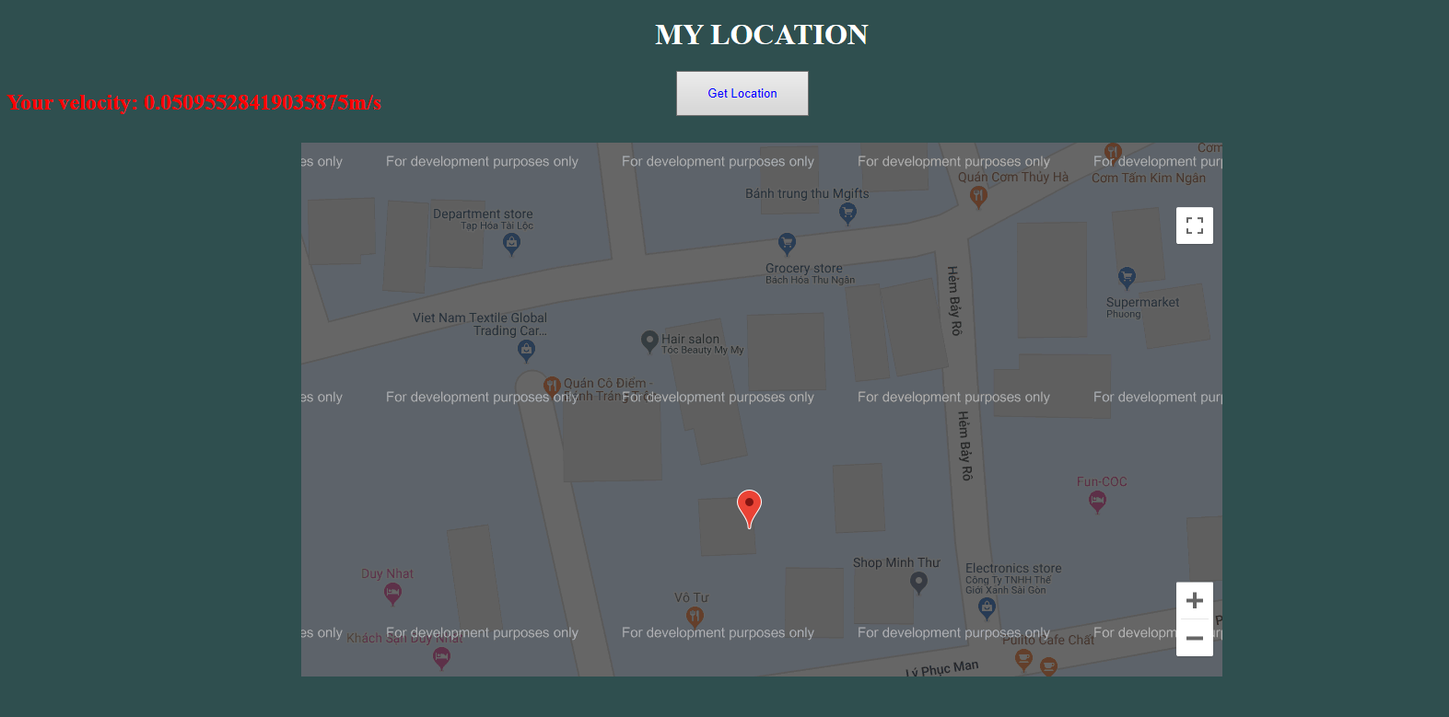
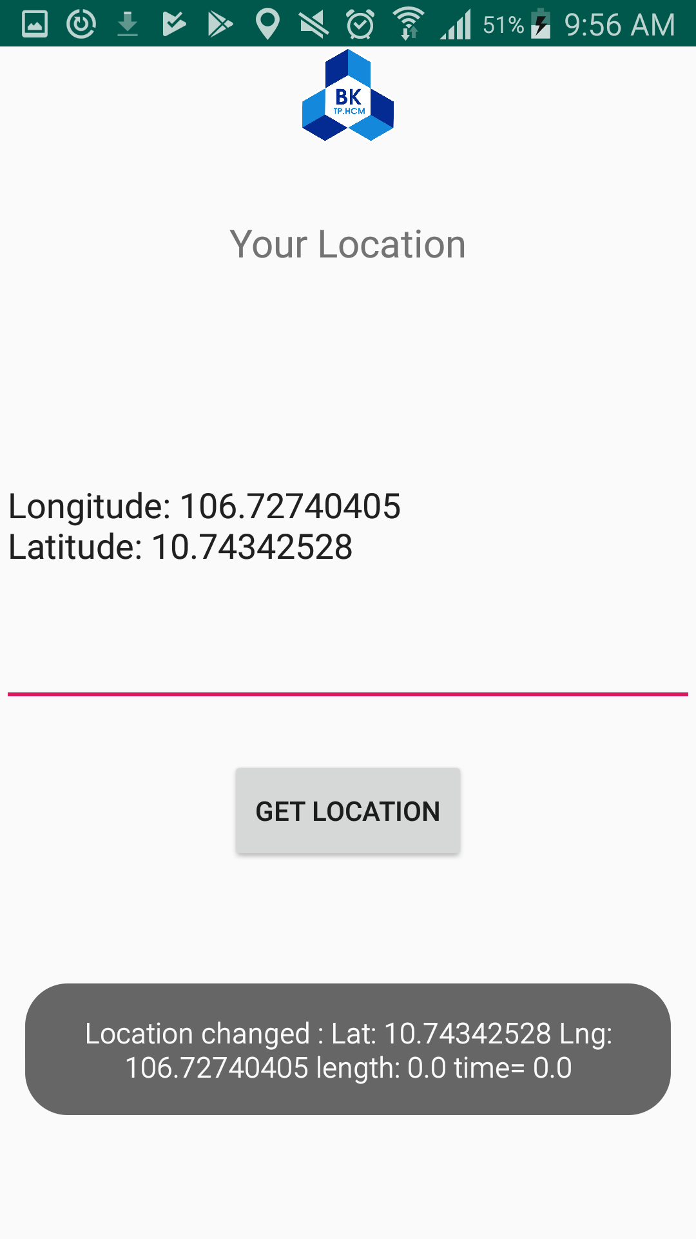
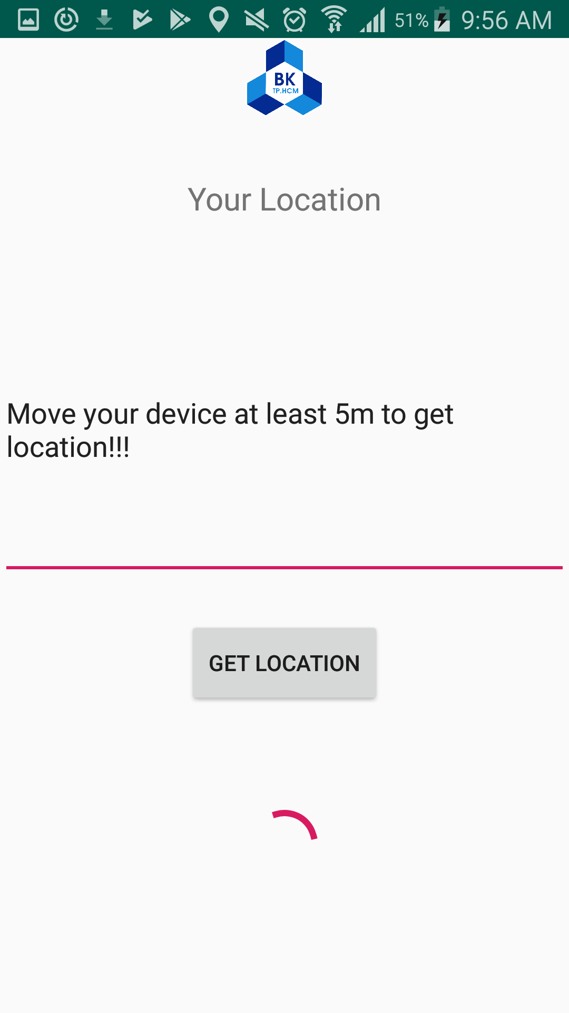
Results
Tracking my location
Show on map

Slide 22
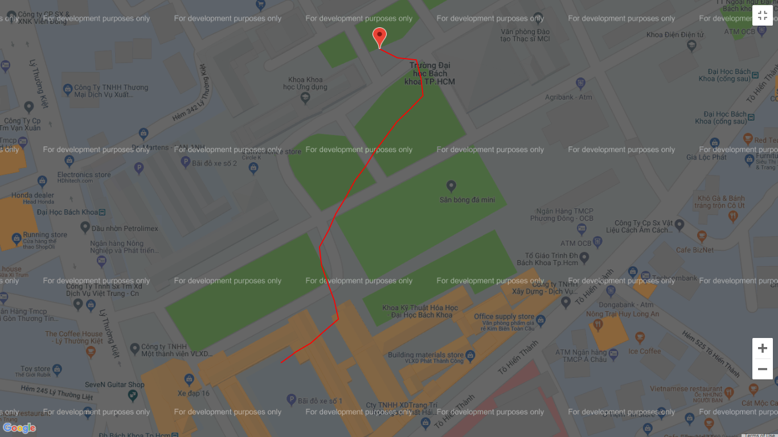
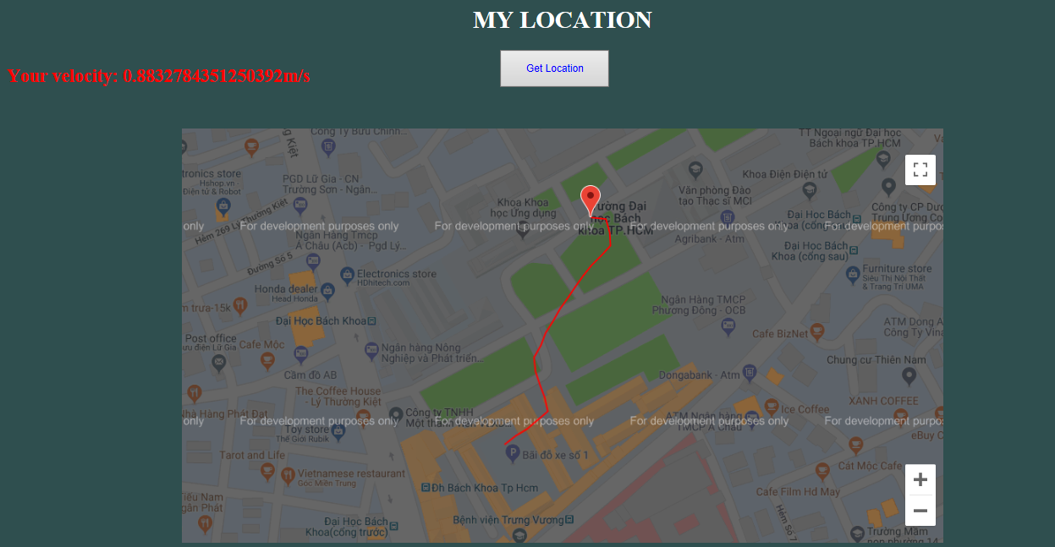
Show the path

Slide 23
References
Stack Overflow: https://stackoverflow.com/
Wikimedia: https://en.wikipedia.org/wiki/Global_Positioning_System
W3School: https://www.w3schools.com/
Android Studio: https://developer.android.com/docs
Devside: https://www.devside.net/wamp-server/accessing-websites-on-a-local-network-lan-web-server
Github: https://github.com/

Slide 24
Thanks!
Any questions?

Slide 25
SlidesCarnival icons are editable shapes.
This means that you can:
Resize them without losing quality.
Change line color, width and style.
Isn’t that nice? :)
Examples:

